Slide 1
Grafică asistată de calculator
Laborator – Grigore Ionuț

Slide 2
Laboratory 2
Classifying Images
with a Vision
Transformer (ViT)

Slide 3
What We'll Do Today
CIFAR-10 Dataset
Multi-Head Attention
01
Download, visualise, augment & batch 60K images across 10 classes
04
4 heads × 12 dims capture patch-to-patch relationships
Patch Embeddings
Encoder & Classifier
02
Slice 32×32 images into 64 patches, encode each with Conv2d
05
Stack 4 encoder blocks; CLS token output → 10-class logits
CLS Token & Positions
Training & Results
03
Add a learnable CLS token + learned positional encodings
06
56.3% accuracy

Slide 4
Section 1
The CIFAR-10
Dataset

Slide 5
1.1 — Downloading & Visualising CIFAR-10
60,000
50,000
10,000
32 × 32
10
6,000
Total images
Training images
Test images
Image size (px)
Classes
Images / class
The 10 classes (label 0–9):
0 plane
1 car
2 bird
3 cat
4 deer
5 dog
6 frog
7 horse
8 ship
9 truck

Slide 6
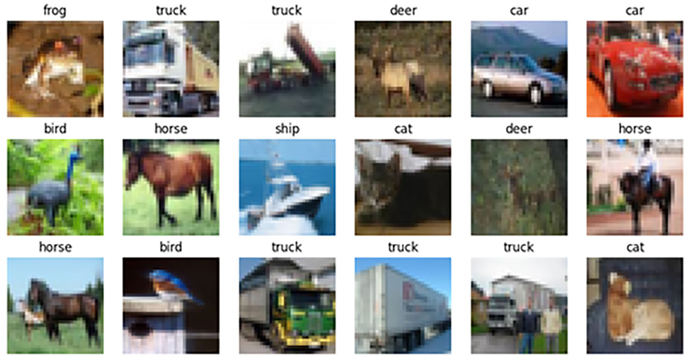
1.1 — Downloading & Visualising CIFAR-10
import torchvision, matplotlib.pyplot as plt
trainset = torchvision.datasets.CIFAR10(root='.', train=True, download=True)
testset = torchvision.datasets.CIFAR10(root='.', train=False, download=True)
names = ['plane','car','bird','cat','deer','dog','frog','horse','ship','truck']
# Visualise first 18 training images in a 3×6 grid
plt.figure(figsize=(12,6), dpi=100)
for i in range(3):
for j in range(6):
plt.subplot(3, 6, 6*i+j+1)
plt.imshow(trainset[6*i+j][0])
plt.axis('off')
plt.title(names[trainset[6*i+j][1]], fontsize=12)
plt.subplots_adjust(hspace=0.20)
plt.show()

Slide 7
1.2 — Transforms, Augmentation & DataLoaders
Images must become PyTorch tensors normalised to [–1, 1]. Training data gets extra augmentations to reduce overfitting:
Training Transform
Test Transform
▸ ToTensor() → float tensor, range [0, 1]
▸ ToTensor() → float tensor, range [0, 1]
▸ Normalize((0.5, 0.5, 0.5), (0.5, 0.5, 0.5)) → [–1, 1]
▸ Normalize((0.5, 0.5, 0.5), (0.5, 0.5, 0.5)) → [–1, 1]
▸ RandomHorizontalFlip(p=0.5) → random mirror
▸ No augmentation — test set must stay fixed
▸ RandomResizedCrop(32, scale=0.8 – 1.0)
import torchvision.transforms as transforms, torch
# Training: with augmentation
trainset.transform = transforms.Compose([
transforms.ToTensor(),
transforms.Resize((32,32), antialias=True),
transforms.RandomHorizontalFlip(p=0.5),
transforms.RandomResizedCrop((32,32), scale=(0.8,1.0), antialias=True),
transforms.Normalize((0.5,0.5,0.5),(0.5,0.5,0.5))])
trainloader = torch.utils.data.DataLoader(trainset, batch_size=32, shuffle=True)
# Test: no augmentation
testset.transform = transforms.Compose([transforms.ToTensor(),
transforms.Resize((32,32), antialias=True),
transforms.Normalize((0.5,0.5,0.5),(0.5,0.5,0.5))])
testloader = torch.utils.data.DataLoader(testset, batch_size=32, shuffle=False)

Slide 8
Section 2
Building a Vision
Transformer (ViT)
from Scratch

Slide 9
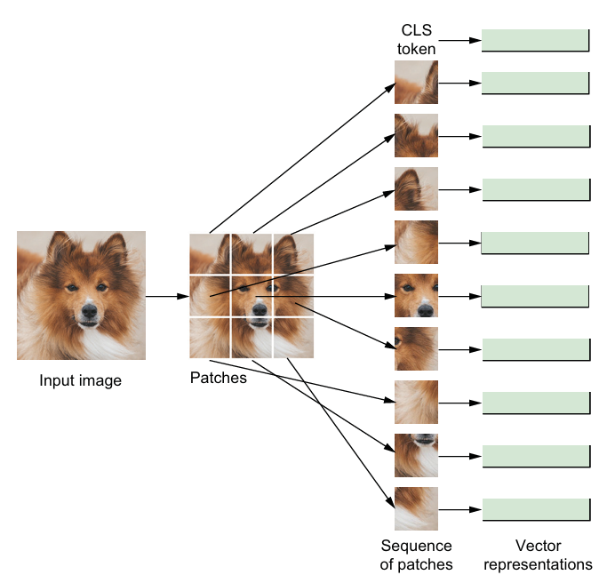

2.1 — Dividing Images into Patches (PatchEmbeddings)
NOTE:
1 token = 1 patch

Slide 10
2.1 — Dividing Images into Patches (PatchEmbeddings)
A Transformer needs a sequence. We create one by slicing the image into 64 small patches:
Input Image
Conv2d
kernel=4, stride=4
Feature Map
Flatten +
Transpose
→
→
→
3 × 32 × 32
(RGB, H, W)
slides once per patch
(no overlap)
48 × 8 × 8
(channels, grid)
→ 64 × 48
64 tokens each 48-dim
class PatchEmbeddings(nn.Module):
def __init__(self, config):
super().__init__()
self.projection = nn.Conv2d(
config.num_channels, # in: 3 (RGB channels)
config.hidden_size, # out: 48 (output channels = token size)
kernel_size=config.patch_size, # 4×4 kernel — one kernel per patch
stride=config.patch_size) # stride=4 — no overlap between patches
def forward(self, x):
x = self.projection(x) # (B, 3, 32, 32) → (B, 48, 8, 8)
x = x.flatten(2).transpose(1, 2) # (B, 48, 8, 8) → (B, 64, 48)
return x # 64 patch tokens, each 48-dim
Output
patchembed(img).shape → torch.Size([1, 64, 48])
↑ batch ↑ number of patches ↑ token dimension

Slide 11
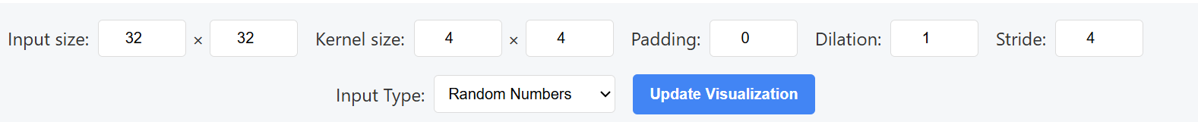
2.1 — Dividing Images into Patches (PatchEmbeddings)
https://kowshik24.github.io/convolution-visualizer/

Slide 12

2.2 — CLS Token & Positional Encoding (Embeddings)
NOTE:
1 token = 1 patch
Positional Encoding

Slide 13
2.2 — CLS Token & Positional Encoding (Embeddings)
🏷 CLS Token (Classification Token)
📍 Positional Encoding (Learned — not sine/cosine)
A single learnable 48-dim vector prepended to the 64 patch tokens.
It has no image content — its role is to collect information from all 64 patches through attention. After the encoder, only the CLS output (position 0) feeds the classifier.
Result: 64 + 1 = 65 tokens in the sequence.
Unlike Lab 1's fixed sinusoidal encoding, here positions are nn.Parameter tensors — shape (1, 65, 48) — learned from data.
Added element-wise to the token embeddings. The model discovers during training which position patterns best represent spatial layout.
Key difference: Lab 1 = fixed formula; Lab 2 = trained weights.
class Embeddings(nn.Module):
def __init__(self, config):
super().__init__()
self.patch_embeddings = PatchEmbeddings(config)
self.cls_token = nn.Parameter( # learnable CLS vector
torch.randn(1, 1, config.hidden_size)) # shape (1, 1, 48)
num_patches = (config.image_size // config.patch_size) ** 2 # = 64
self.position_embeddings = nn.Parameter( # learned positions
torch.randn(1, num_patches + 1, config.hidden_size)) # shape (1, 65, 48)
def forward(self, x):
x = self.patch_embeddings(x) # (B, 64, 48)
cls = self.cls_token.expand(x.size(0),-1,-1) # (B, 1, 48)
x = torch.cat([cls, x], dim=1) # (B, 65, 48) ← CLS first
x = x + self.position_embeddings # add position info
return x
Look into the diagram from previous slide and try to associate ☺
Output:
embed(img).shape → torch.Size([1, 65, 48]) ← 1 CLS + 64 patches
embed.position_embeddings.shape → torch.Size([1, 65, 48]) ← learned positions

Slide 14
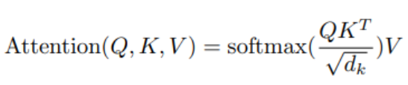
2.3 — Multi-Head Self-Attention
Each of the 65 tokens attends to every other token. 48 dims split into 4 heads × 12 dims:
Input X (B × 65 × 48)
Head 1
Q, K, V: (65×12) → (65×12)
Head 2
Q, K, V: (65×12) → (65×12)
Head 3
Q, K, V: (65×12) → (65×12)
Head 4
Q, K, V: (65×12) → (65×12)
Concatenate (65 × 48) → Linear projection → output (65 × 48)
class AttentionHead(nn.Module):
def __init__(self, hidden_size, attention_head_size):
super().__init__()
self.attention_head_size = attention_head_size
self.query = nn.Linear(hidden_size, attention_head_size) # 48 → 12
self.key = nn.Linear(hidden_size, attention_head_size) # 48 → 12
self.value = nn.Linear(hidden_size, attention_head_size) # 48 → 12
def forward(self, x):
Q, K, V = self.query(x), self.key(x), self.value(x)
scores = torch.matmul(Q, K.transpose(-1,-2)) # (65×65) similarity
scores = scores / math.sqrt(self.attention_head_size) # scale by √12
probs = nn.functional.softmax(scores, dim=-1) # (65×65) probabilities
output = torch.matmul(probs, V) # (65×12) attended values
return output, probs
class MultiHeadAttention(nn.Module):
# creates 4 AttentionHead objects, runs each, concatenates outputs → (65×48)
Try to see this:
__

Slide 15
Try to focus on the big picture and not get lost in details

Slide 16
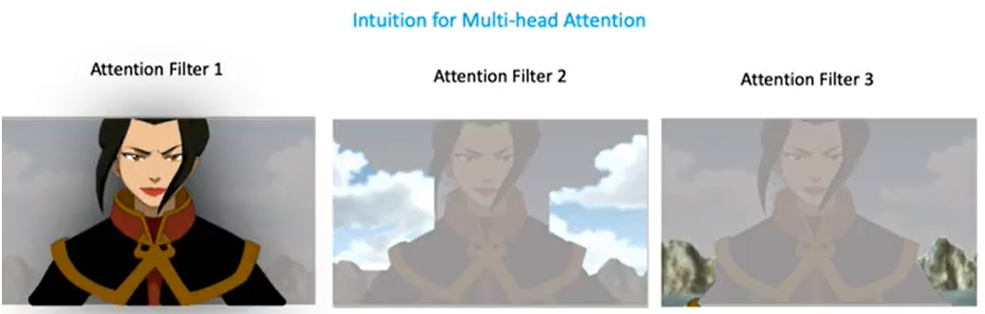

2.3 — Multi-Head Self-Attention
48 ÷ 4 heads = 12 dimensions per head

Slide 17

2.4 — Encoder Block

Slide 18
2.4 — Encoder Block
Input x (B × 65 × 48)
class MLP(nn.Module):
def __init__(self, config):
super().__init__()
self.dense_1 = nn.Linear(config.hidden_size, config.intermediate_size)
# 48 → 192
self.activation = GELU()
self.dense_2 = nn.Linear(config.intermediate_size, config.hidden_size) # 192 → 48
class Block(nn.Module):
def forward(self, x):
attn_out, attn_probs = self.attention(self.layernorm_1(x))
x = x + attn_out # residual connection 1
mlp_out = self.mlp(self.layernorm_2(x))
x = x + mlp_out # residual connection 2
return x, attn_probs
class Encoder(nn.Module):
def forward(self, x):
for block in self.blocks: # 4 blocks in sequence
x, attn = block(x)
return x, all_attentions
LayerNorm → MultiHeadAttention
Add Residual ( x = x + attn )
LayerNorm → MLP (48 → 192 → 48)
Add Residual ( x = x + mlp )
Output (B × 65 × 48)
Lab 1 vs Lab 2 — Architecture Difference
× 4 encoder blocks
Lab 1 used Encoder + Decoder (translation: German→English).
Lab 2 uses Encoder-Only — we only need to understand the image, not generate tokens.
💡 GELU (Gaussian Error Linear Unit): a fancier version of ReLU

Slide 19
2.5 — Assembling the Full ViT Classifier
All components connect: image → patches → CLS+positions → encoder → CLS out → classify:
Input
Image
(B,3,32,32)
Embeddings
Patches+CLS
+Positions
(B,65,48)
Encoder
4 × Block
(B,65,48)
CLS token
[:, 0, :]
(B, 48)
Linear
Classifier
(B, 10)
→
→
→
→
class ViTForClassfication(nn.Module):
def __init__(self, config):
super().__init__()
self.embedding = Embeddings(config) # patches + CLS + positions
self.encoder = Encoder(config) # 4 stacked encoder blocks
self.classifier = nn.Linear(config.hidden_size, # 48 → 10
config.num_classes)
def forward(self, x, output_attentions=False):
x = self.embedding(x) # (B, 65, 48)
x, attention_maps = self.encoder(x, output_attentions) # (B, 65, 48)
logits = self.classifier(x[:, 0, :]) # CLS only → (B, 10)
return logits, attention_maps # logits + attention
model = ViTForClassfication(config).to(device)
💡 x[:, 0, :] — extracts position 0 (the CLS token) from each image's 65-token sequence.
Only this single vector is passed to the classifier. The 64 patch token outputs are discarded.

Slide 20

Remember this ☺
NOTE:
1 token = 1 patch
Positional Encoding

Slide 21
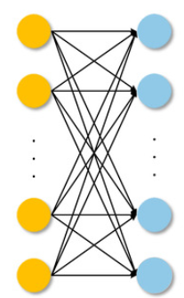


- vector with 48 elements
48
Linear Layer
10
WHY?

Slide 22
Section 3
Training &
Classification

Slide 23
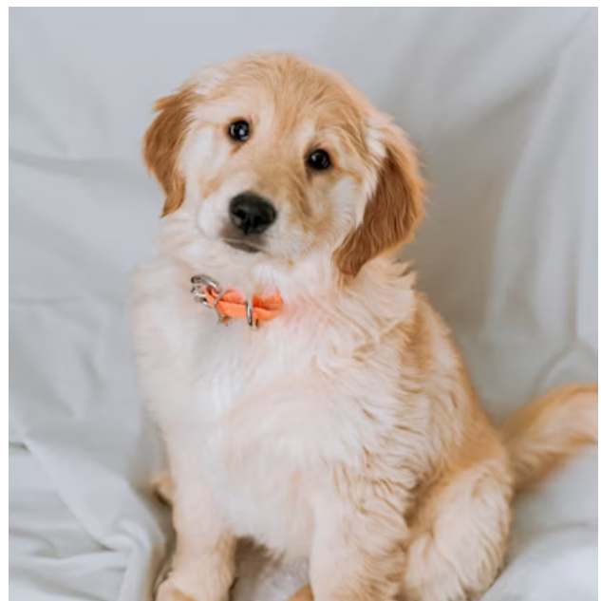

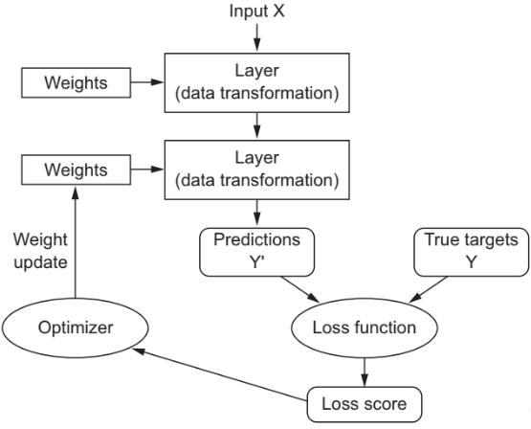














ML/DL
model
very good
numbers
“dog”
“dog”
0.05 - low

Slide 24

3.1 — Optimizer, Loss Function & Mixed Precision
AdamW (lr=0.01, weight_decay=1e-2)
CrossEntropyLoss
TL;DR
A fancier version of this:
Standard loss for multi-class classification.
The model outputs 10 raw logits.
The loss measures how far the softmax probability of the correct class is from 1.0.
The model is penalised for assigning low probability to the true label.
Automatic Mixed Precision (torch.amp.GradScaler)
Uses float16 for most forward-pass ops (faster, less memory) and float32 for numerically sensitive ops (loss, softmax).
Result: ~2× training speedup with no meaningful accuracy loss.
optimizer = optim.AdamW(model.parameters(), lr=0.01, weight_decay=1e-2)
loss_fn = nn.CrossEntropyLoss()
scaler = torch.amp.GradScaler() # mixed-precision gradient scaler
def train_batch(batch):
images, labels = [t.to(device) for t in batch]
with torch.amp.autocast(device): # float16 forward pass
loss = loss_fn(model(images)[0], labels)
optimizer.zero_grad()
scaler.scale(loss).backward() # scaled backward pass
scaler.step(optimizer) # update weights
scaler.update()
return loss.item() * len(images) / len(trainloader.dataset)

Slide 25
Try to focus on the big picture and not get lost in details

Slide 26
3.2 — Early Stopping & Training Loop
🛑 EarlyStop (patience = 3)
💾 Best-model saving
Tracks the minimum test loss seen so far.
• If new loss < min → save model weights, reset counter
• If new loss ≥ min → increment counter
• If counter reaches patience (3) → stop training
Stopped at epoch 13; best model was at epoch 10.
Only the epoch that achieves a new minimum test loss gets saved to files/ViT.pth.
This ensures that even though we keep training past the best point (waiting for patience to expire), we always end up with the best-ever weights, not the latest weights.
early_stop = EarlyStop(patience=3)
for epoch in range(100):
model.train()
trainL = sum(train_batch(b) for b in trainloader) # one full epoch
model.eval()
with torch.no_grad():
testL = 0
for imgs, lbls in testloader:
logits, _ = model(imgs.to(device))
testL += loss_fn(logits, lbls.to(device)).item() * len(imgs) / len(testloader.dataset)
print(f'Train / Test loss: {trainL:.4f} {testL:.4f}')
stop, save = early_stop.stop(testL)
if save:
torch.save(model.state_dict(), 'files/ViT.pth')
if stop:
break # no improvement for 3 consecutive epochs → halt

Slide 27


3.2 — Training Progress (13 Epochs)
Epoch 1
Loss: 1.835
Epoch 5
Loss: 1.318
Epoch 10 ★ Best
Test: 1.092
Epoch 13
Early stop
💡 After epoch 10 the test loss stops falling (model starts overfitting). EarlyStop counts 3 non-improving epochs (11, 12, 13) then halts. The epoch 10 weights are what gets deployed.

Slide 28

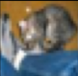
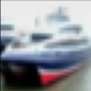


3.3 — Classifying Images with the Trained ViT
56.3%
Sample predictions from the first batch of 32 test images:
Output
Test Accuracy
...
# Load best weights
model.load_state_dict(torch.load('files/ViT.pth'))
model.eval()
# Get a batch and run inference
with torch.no_grad():
images, labels = next(iter(testloader))
logits, attention_maps = model(images.to(device), output_attentions=True)
predictions = torch.argmax(logits, dim=1) # highest logit = predicted class
# Evaluate on full test set
acc = 0
with torch.no_grad():
for imgs, lbls in testloader:
logits, _ = model(imgs.to(device))
acc += torch.sum(torch.argmax(logits,dim=1) == lbls.to(device)).item() / len(testloader.dataset)
print(f'Accuracy: {acc:.4f}') # → 0.5627
💡 56.3% is strong for such a compact model (only ~200K parameters).
A pretrained ViT-Base from Google (~86M parameters) reaches 98%+ on CIFAR-10 — scale and pretraining make the difference.

Slide 29
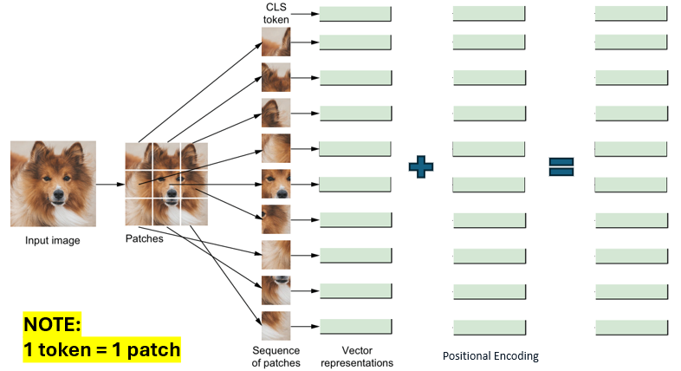

TL;DR
Transformer Encoder
48
10
Linear Layer

Slide 30
Lab Exercises
Plot the first 18 test-set images in a 3×6 grid
1
Use plt.subplot(3,6,...), plt.imshow(), plt.axis('off'), and plt.title() with class names. Same structure as the training-set visualisation in section 1.1.
Hint: Replace trainset with testset. The structure is identical.
What does print(config.num_classes) output?
2
Access the class variable using dot notation. Explain what this value represents in the context of the CIFAR-10 classification task.
Hint: Config defines num_classes = 10 (one class = one CIFAR-10 category: plane, car, bird, ...)
PatchEmbeddings output shape for a batch of 5
3
Use torch.randn((5, 3, 32, 32)) to create 5 fake images. Pass through PatchEmbeddings. Print the shape and explain what each of the 3 numbers means.
Hint: Expected: torch.Size([5, 64, 48]) → 5 images, 64 patches each, 48-dim vectors

Slide 31


Slide 32
Ex 1
Plot the First 18 Test-Set Images in a 3×6 Grid
❓ Plot the first 18 images from testset in a 3×6 grid. Use axis('off') and place the class name as the title of each image.
plt.figure(figsize=(12, 6), dpi=100)
for i in range(3):
for j in range(6):
plt.subplot(3, 6, 6*i+j+1)
plt.imshow(testset[6*i+j][0]) # [0] = image
plt.axis('off') # hide axis
plt.title(names[testset[6*i+j][1]], fontsize=12)
plt.subplots_adjust(hspace=0.20)
plt.show()
Training code (section 1.1)
Solution — just change to testset
▸ trainset[6*i+j][0] ← image
▸ testset[6*i+j][0] ← image
▸ trainset[6*i+j][1] ← label
▸ testset[6*i+j][1] ← label
▸ 50,000 training images
▸ 10,000 test images
💡 The only change is trainset → testset on every line. Loop, grid, axis('off'), title, and hspace are all identical to section 1.1.

Slide 33
Ex 2
What Does print(config.num_classes) Output?
❓ Use dot notation to access config.num_classes. What is the output, and what does it mean in the context of CIFAR-10?
class Config:
patch_size=4
hidden_size=48
num_hidden_layers=4
num_attention_heads=4
intermediate_size=4*48
image_size=32
num_classes=10
num_channels=3
config = Config()
print(config.num_classes) # dot notation reads the class variable
Output
10
Why 10?
Where is it used?
What do 10 outputs mean?
CIFAR-10 has exactly 10 categories:
plane, car, bird, cat, deer, dog, frog, horse, ship, truck.
Each image has one label from 0–9.
In ViTForClassification:
self.classifier =
nn.Linear(hidden_size, # 48
num_classes) # 10
Sets the classifier output.
The model produces 10 raw logit scores.
The index of the highest score = predicted class:
predictions = torch.argmax(logits, dim=1)
💡 All Config fields use dot notation: config.hidden_size → 48 | config.patch_size → 4 | config.num_attention_heads → 4 | config.image_size → 32

Slide 34
Ex 3
PatchEmbeddings Output Shape for a Batch of 5
❓ Generate torch.randn((5, 3, 32, 32)). Pass it through PatchEmbeddings. Print the shape and explain what each number means.
patchembed = PatchEmbeddings(config)
imgs = torch.randn((5, 3, 32, 32)) # 5 images, 3 RGB channels, 32×32 resolution
out = patchembed(imgs)
print(out.shape)
Output
torch.Size([5, 64, 48])
5
64
48
Batch size
Patches per image
Patch vector size
We passed 5 images in at once.
In training the DataLoader sends 32 per batch.
Using 5 here just tests the shape logic.
Each 32×32 image → 8×8 grid:
32 ÷ patch_size(4) = 8
8 × 8 = 64 patches per image.
Conv2d maps each 4×4 patch to a 48-dim vector.
48 = config.hidden_size — the token dimension throughout the model.
💡 Lab demo: torch.randn((1,3,32,32)) → [1,64,48]. Changing 1→5 only affects the batch dimension. 64 patches and 48-dim encoding are always fixed for 32×32 images.

Slide 35
Thank you !

